Slide 1
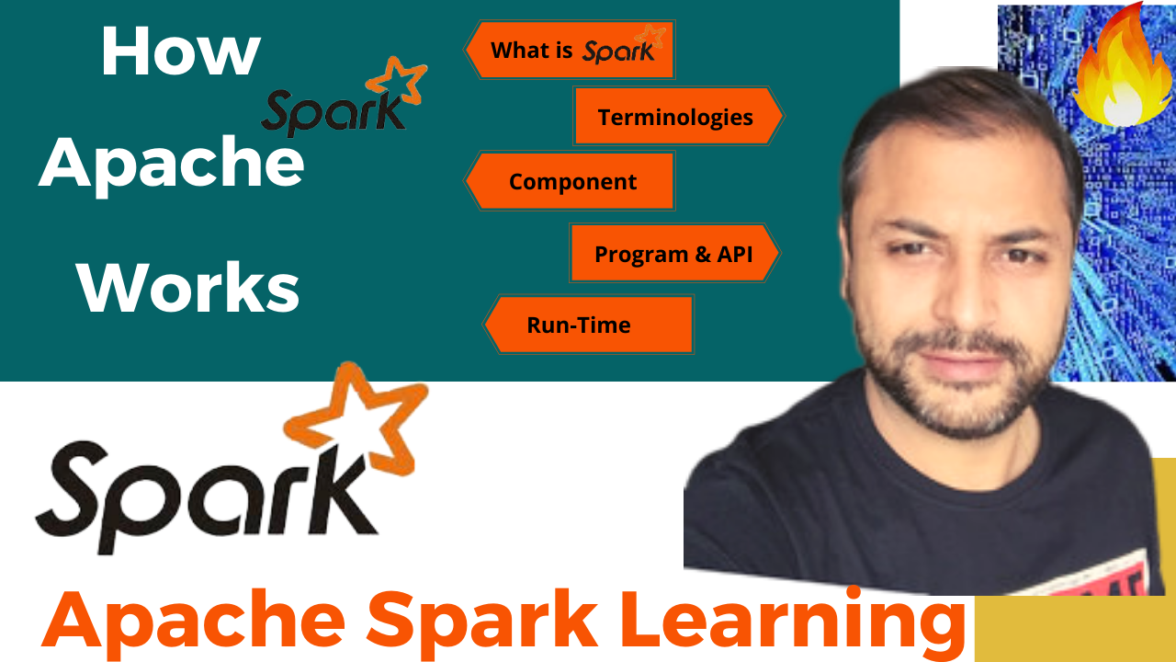
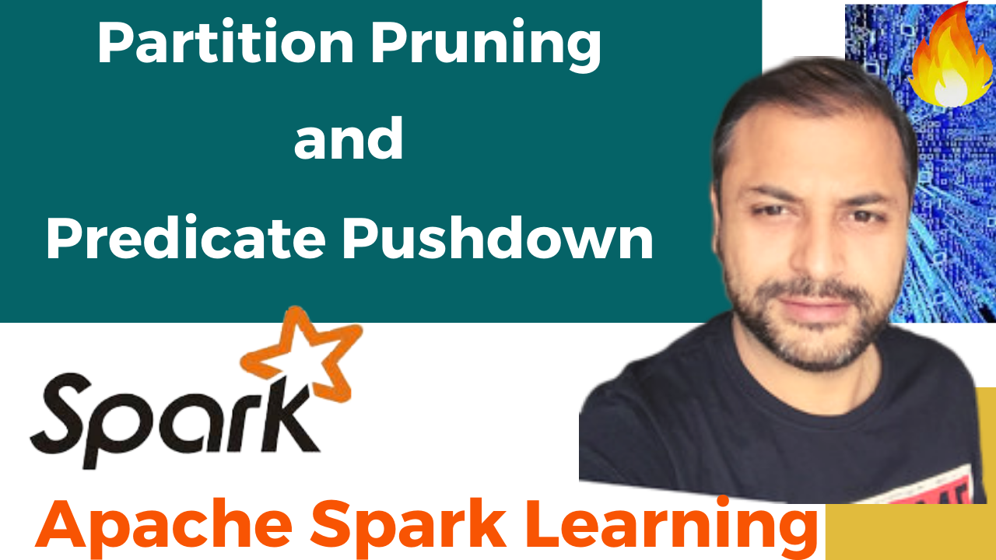
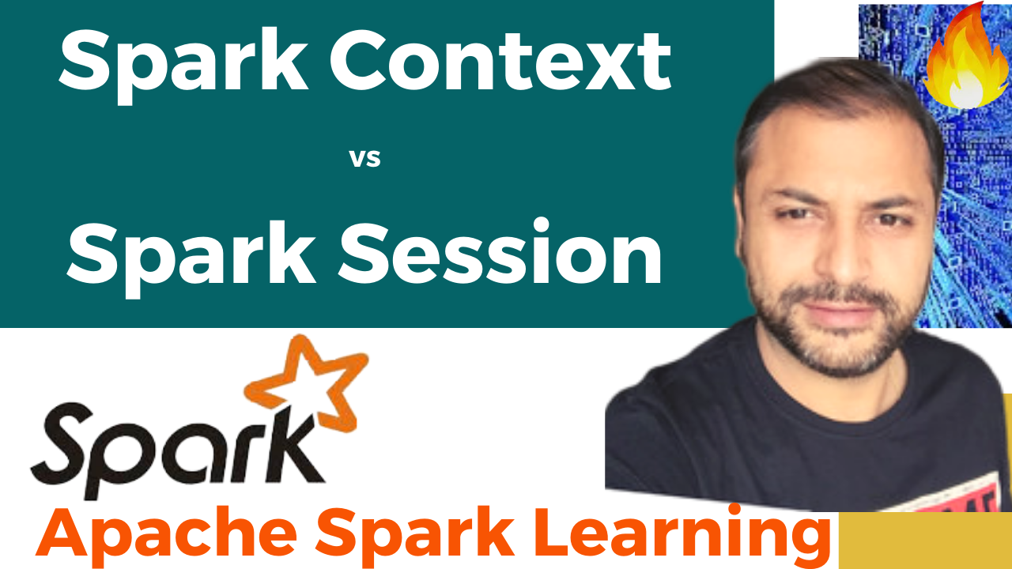


Partition Pruning
&
Predicate Pushdown
Interview Question

Slide 2
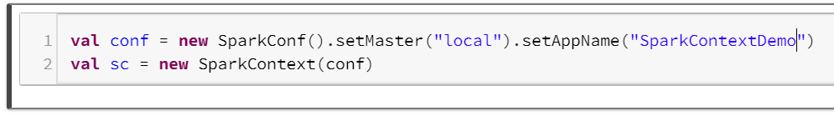

Spark : Context Vs Session
Spark Session is a unified entry point of a spark application from Spark 2.0.
Prior to Spark 2.0 , Spark Context was the entry point of any spark application and used to access all spark features and needed a sparkConf.
It provides a way to interact with various spark’s functionality with a lesser number of constructs.
Instead of having a spark context, hive context, SQL context, now all of it is encapsulated in a Spark session.
Note: Spark Session is the combination of all these Contexts.

Slide 3

Why Spark Session
Obvious answer is - unifies all the different contexts in spark and avoids the developer to worry about creating difference contexts.
But the big advantage is →
Handling of independent , isolated configurations for the Spark Application run, with the help of multiple Spark Sessions.
All Spark Sessions will point to the same spark context within a spark application.
But
Each spark session would have their own set of configurations, table, view and other properties.

Slide 4

Spark Context
Spark Application
Executor
Driver
Executor
Spark Context
Cluster Manager
Executor
Spark Conf
Executor
Executor

Slide 5

Spark : Context Vs Session
Multiple spark contexts by setting
spark.driver.allowMultipleContexts to true .
Multiple spark contexts in the same jvm is not encouraged and is not considered as a good practice as it makes it more unstable.
Crashing of 1 spark context can affect the other.

Slide 6

Spark Session
Spark Application
Driver
Executor
Spark Session-1
Spark Conf-1
Executor
Spark Session-2
Spark Context
Spark Conf-2
Cluster Manager
Executor
Executor
Spark Session-n
Spark Conf-n
Executor

Slide 7
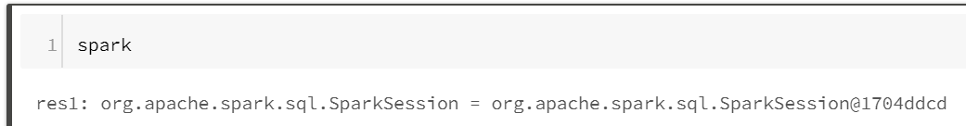
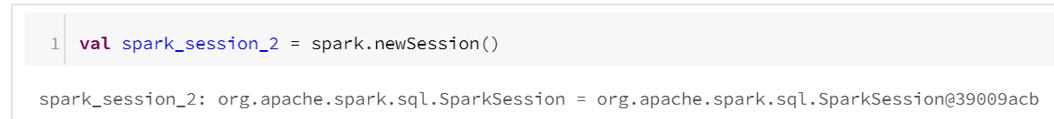
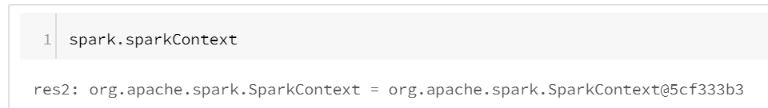
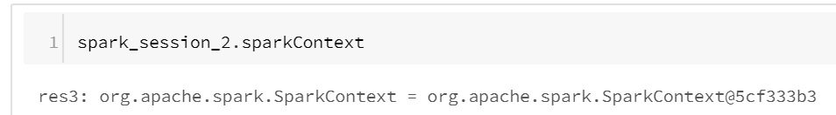
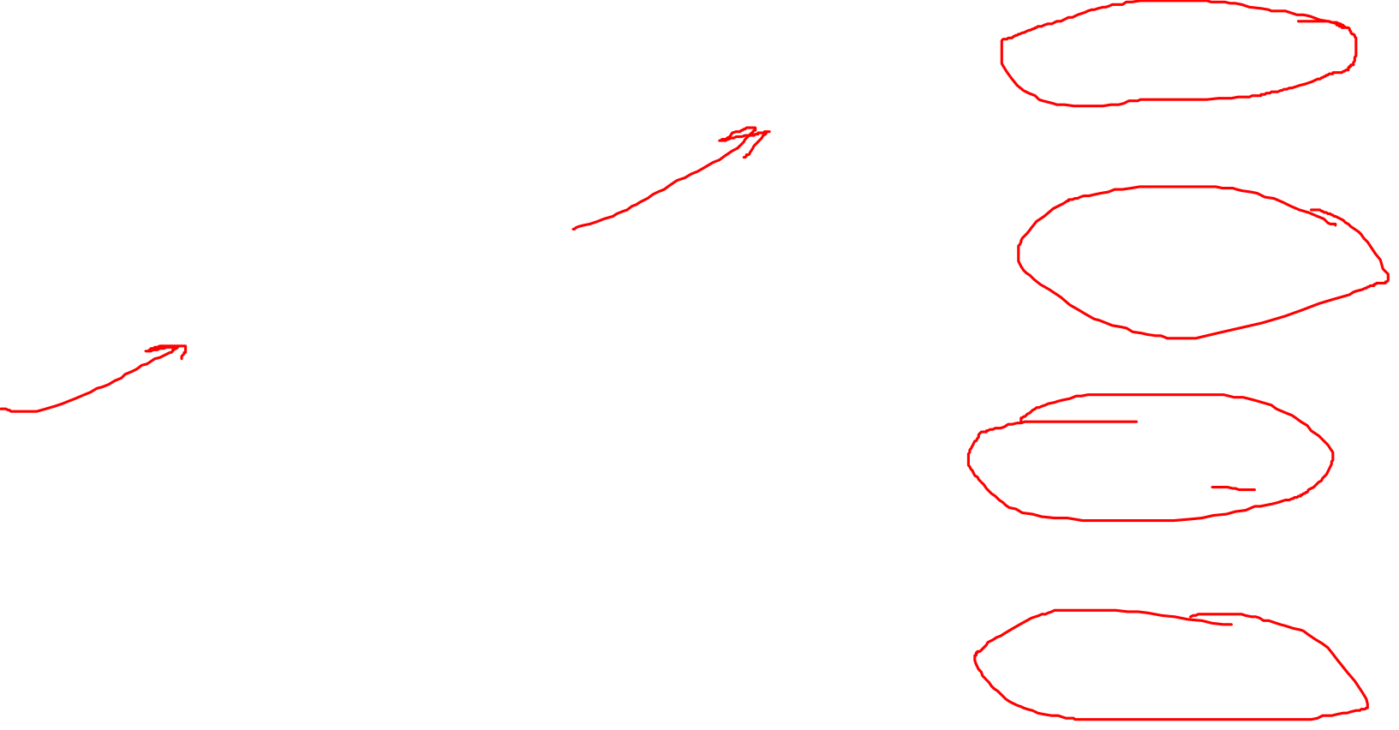
Each Spark Session in an Application will share the same Spark Context

Slide 8
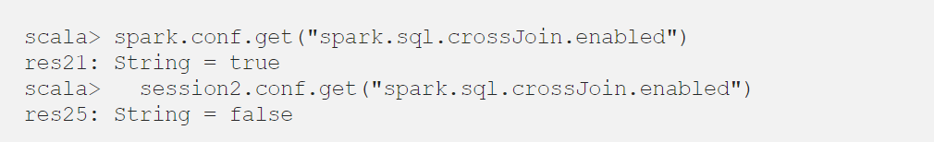

Spark : Context Vs Session
Each Spark Session in an Application will have their isolated set of conf

Slide 9
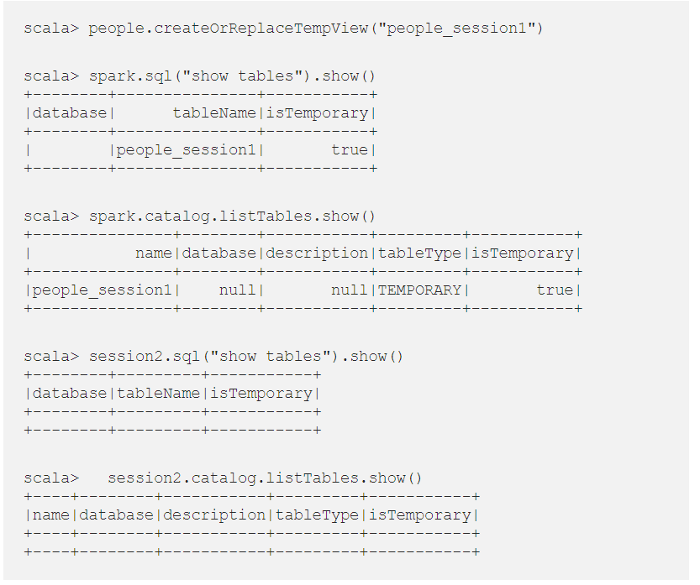

Each Spark Session in an Application will have their isolated set of Table and views

Slide 10
Spark : Context Vs Session
Thanks and do subscribe to my channel

